Slide 1
UK BANK Customer Segmentation
File created on: 3/17/2022 11:42:36 AM

Slide 2
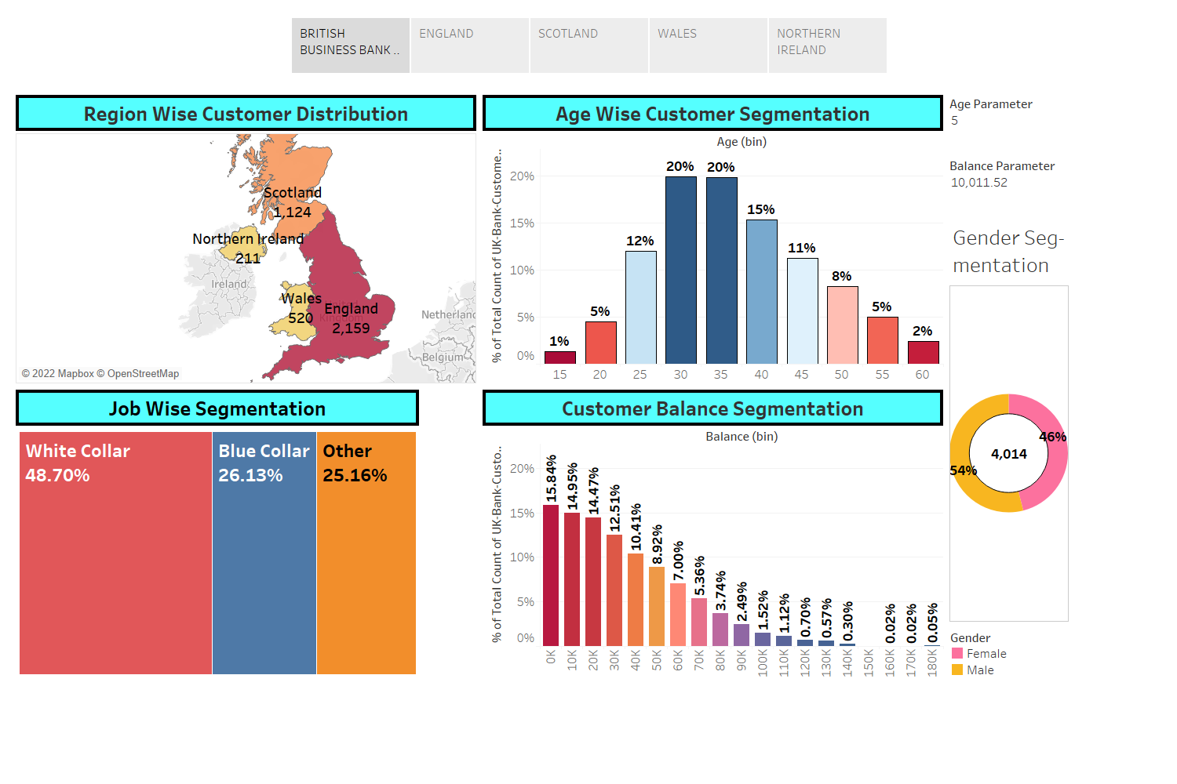

Slide 3
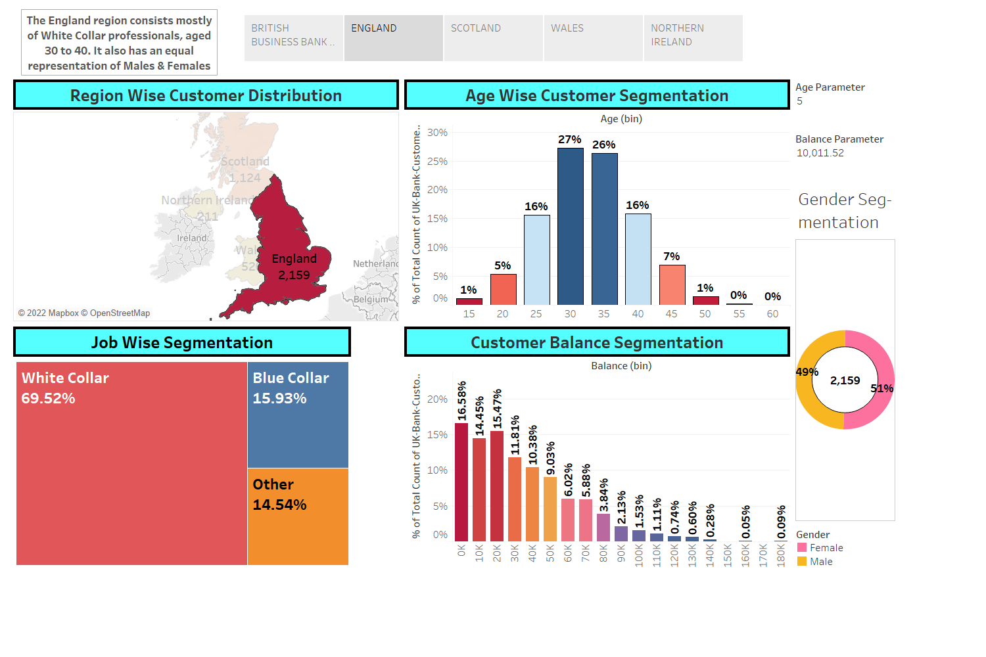

Slide 4
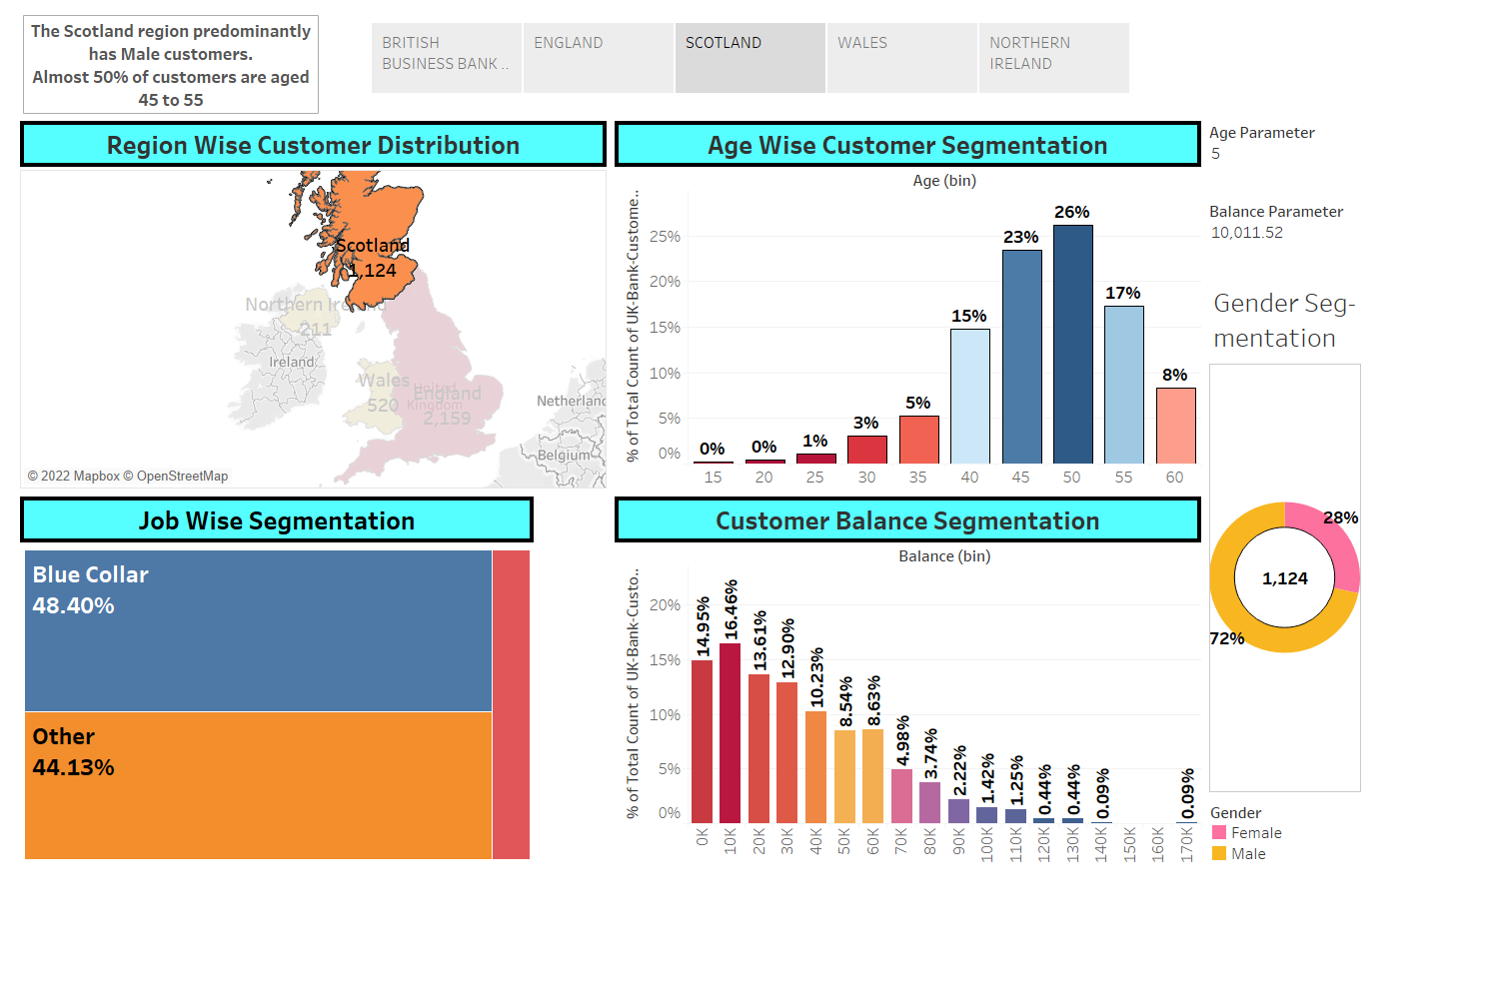

Slide 5
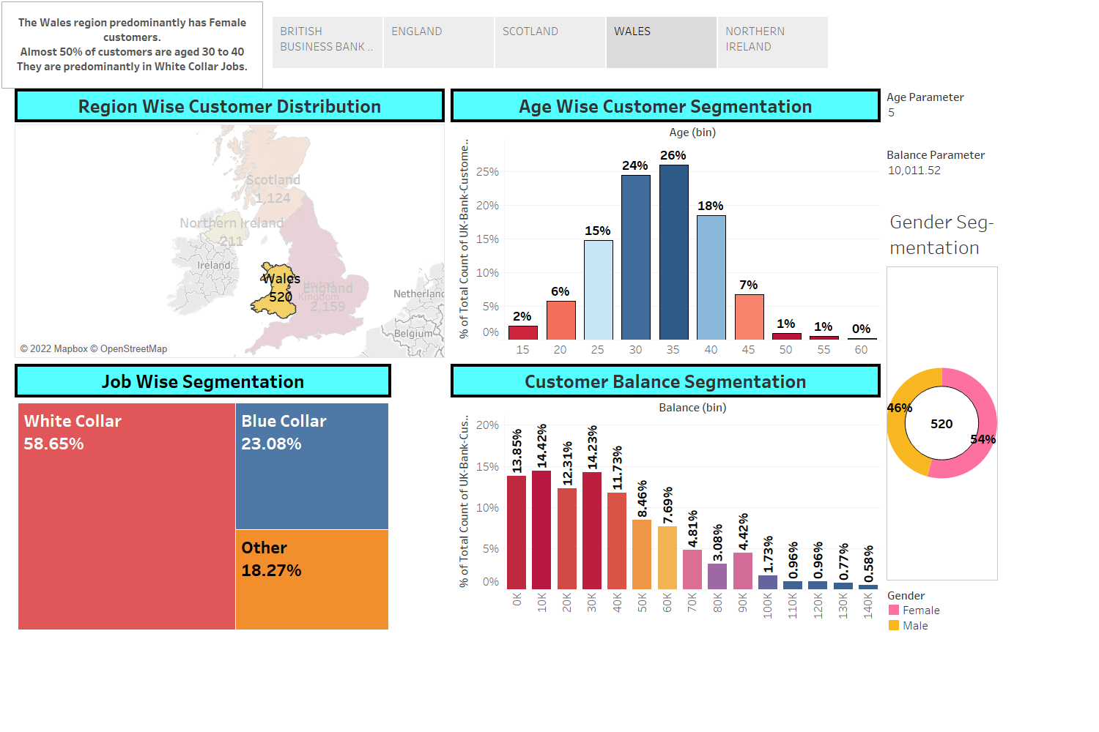

Slide 6
